Slide 1
Basic concepts in statistics
Advanced Statistical Analyses in Natural Resource Sciences (NRES 776)
Instructor: Heather Bryan
Sept 14, 2021

Slide 2
Purpose of statistics

Slide 3
Purpose of statistics
Parameter estimation

Slide 4
Purpose of statistics
Parameter estimation
-use data from a sample to estimate the true value of a parameter in the target population

Slide 5
Purpose of statistics
Parameter estimation
-use data from a sample to estimate the true value of a parameter in the target population
-e.g., mean and variance, proportions, relationships between variables

Slide 6
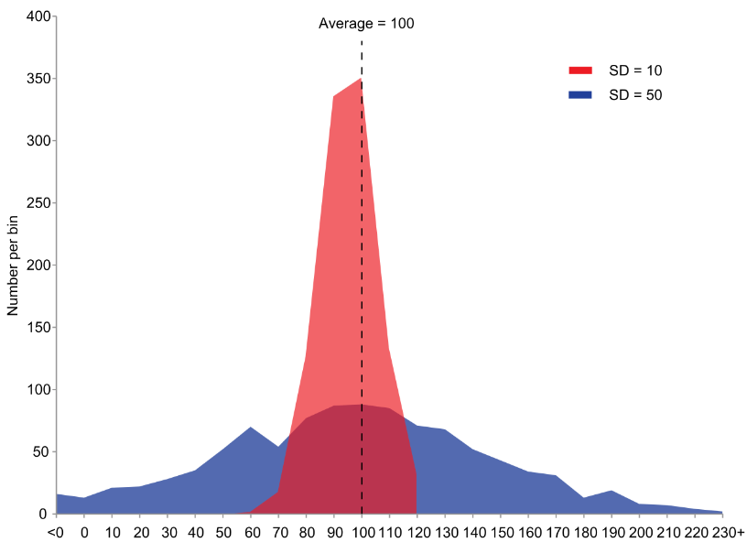
Purpose of statistics
Parameter estimation
-use data from a sample to estimate the true value of a parameter in the target population
-e.g., mean and variance, proportions, relationships between variables

Slide 7
Purpose of statistics
2) Hypothesis testing

Slide 8
Purpose of statistics
2) Hypothesis testing
-use data to evaluate evidence for or against statistical hypotheses

Slide 9
Purpose of statistics
2) Hypothesis testing
-use data to evaluate evidence for or against statistical hypotheses
-discriminate among hypotheses with a certain degree of confidence

Slide 10
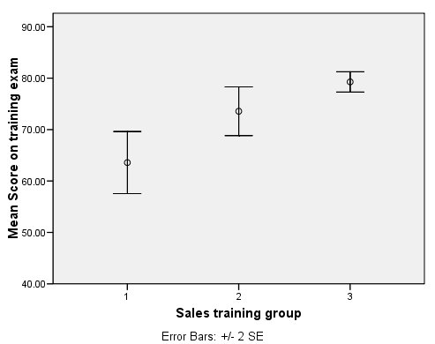
Purpose of statistics
2) Hypothesis testing
-use data to evaluate evidence for or against statistical hypotheses
-discriminate among hypotheses with a certain degree of confidence
-e.g., is there a difference in means between sites or treatments?

Slide 11
Sampling populations
Population

Slide 12
Sampling populations
Population
-totality of possible observations about which inferences are to be made

Slide 13
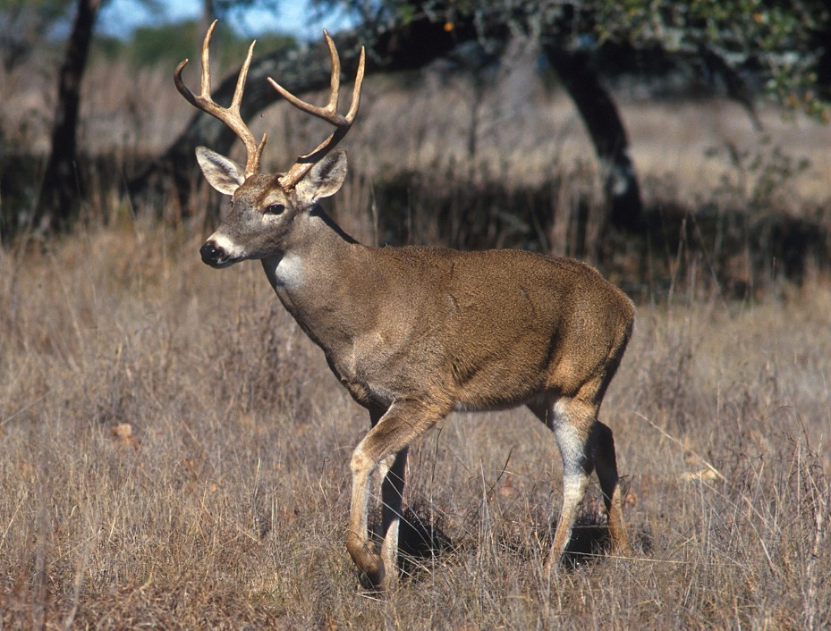
Sampling populations
Population
-totality of possible observations about which inferences are to be made
-usually large number of individuals
-e.g., white-tailed deer population in BC
http://www.ars.usda.gov/is/graphics/photos/may01/k5437-3.htm

Slide 14
Sampling populations
Sample
-smaller subset of individuals taken from a population
-level at which replication occurs and independence is achieved
-e.g., single individual, single gene within genome, family group or nest
http://www.ars.usda.gov/is/graphics/photos/may01/k5437-3.htm

Slide 15
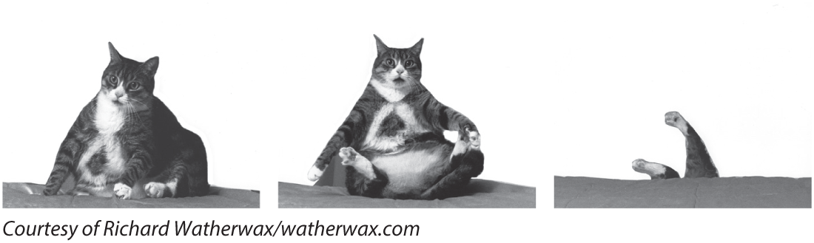
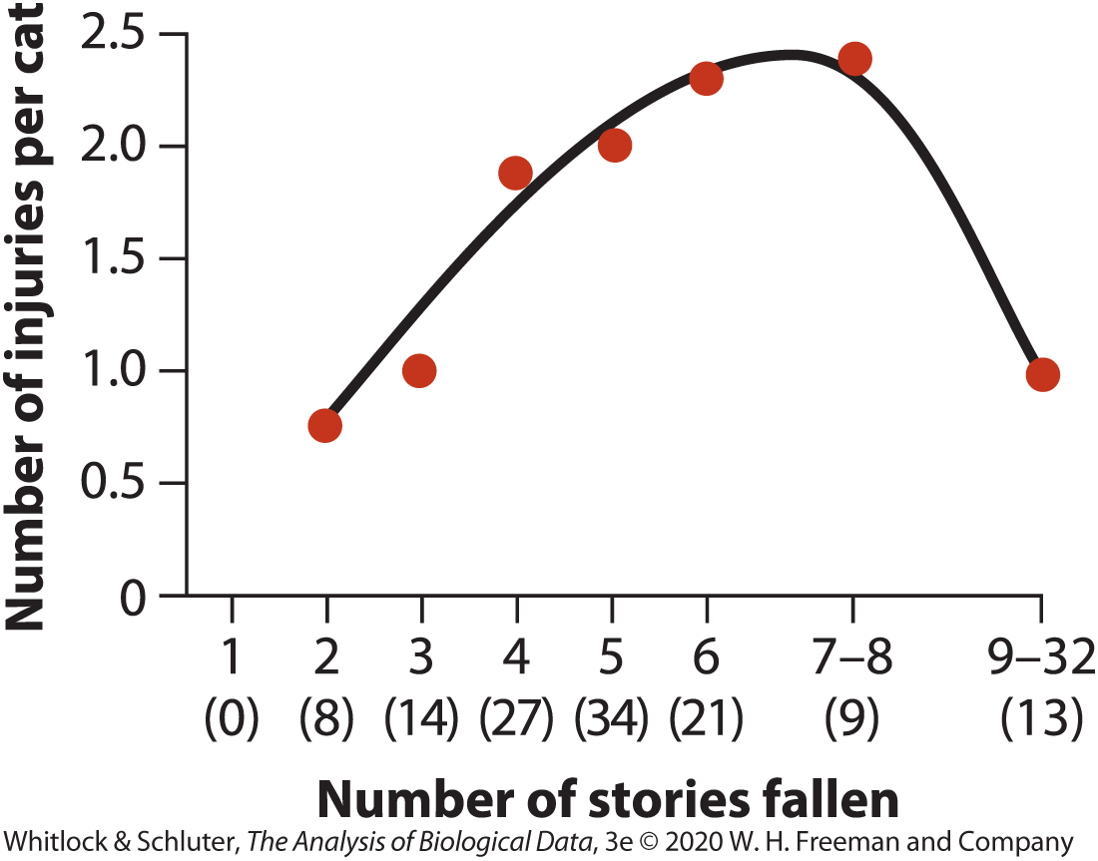
Properties of good samples

Slide 16
Properties of good samples
Overall goal is to minimize sampling error
Chance difference from truth caused by sampling

Slide 17
Properties of good samples
Overall goal is to minimize sampling error
Chance difference from truth caused by sampling
Accuracy: how close an estimate is to the true value for the target population, often hard to measure
E.g., systematic discrepancies or bias, such as males being more likely to show up in traps than females

Slide 18
Properties of good samples
Overall goal is to minimize sampling error
Chance difference from truth caused by sampling
Accuracy: how close an estimate is to the true value for the target population, often hard to measure
E.g., systematic discrepancies or bias, such as males being more likely to show up in traps than females
Precision: measure of variability of variates around the mean
Influenced by sample size
Measurement error—added error due to equipment

Slide 19
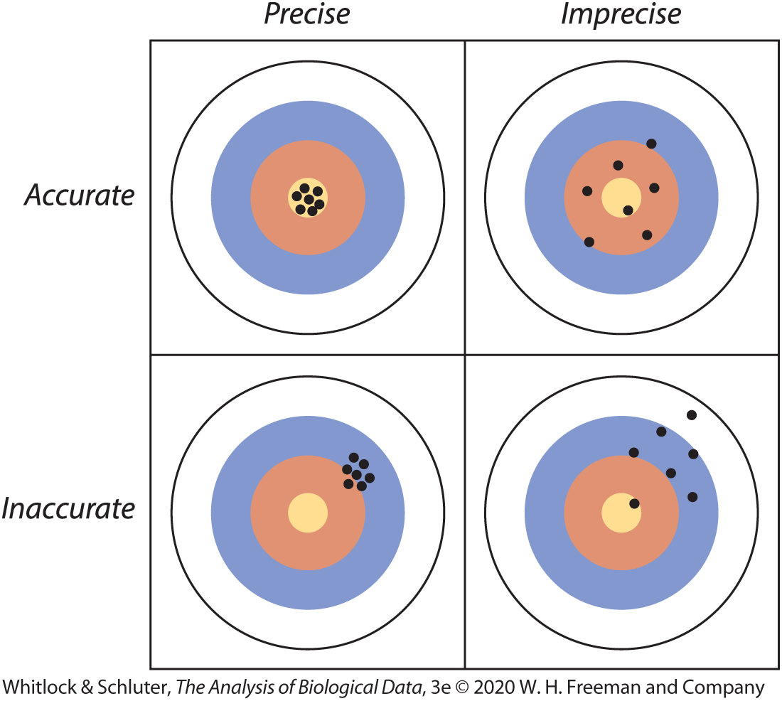
Accuracy vs. Precision

Slide 20
Random sampling
Every unit in a population must have an equal chance of being included in the sample

Slide 21
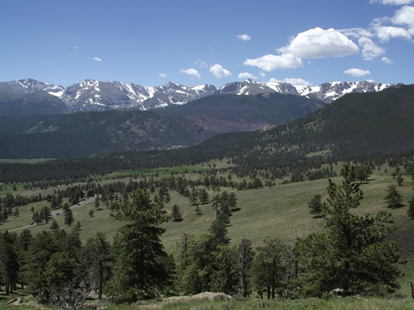
Random sampling
Every unit in a population must have an equal chance of being included in the sample
Difficult to do (e.g., some individuals inaccessible, trap-shy)
http://www.rockymountainhikingtrails.com/deer-mountain.htm

Slide 22
Random sampling
Units must be independent

Slide 23
Random sampling
Units must be independent
Selection of one member of a population does not influence selection of another member of the population

Slide 24
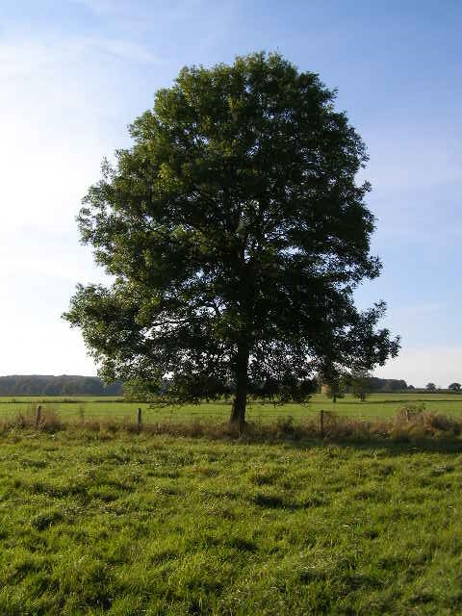
Random sampling
Units must be independent
Selection of one member of a population does not influence selection of another member of the population
E.g., leaves on same tree may be more similar in veination pattern than leaves on different tree
Brian Green/Wikipedia.org

Slide 25
Types of variables
Variable
Characteristic that differs among sampling units or individuals (e.g., coat colour, leaf length)

Slide 26
Types of variables
Variable
Characteristic that differs among sampling units or individuals (e.g., coat colour, leaf length)
Explanatory variable: treatment variable that is hypothesized to influence the response variable (independent)

Slide 27
Types of variables
Variable
Characteristic that differs among sampling units or individuals (e.g., coat colour, leaf length)
Explanatory variable: treatment variable that is hypothesized to influence the response variable (independent)
Response variable: one where you are interested in evaluating an effect (dependent)

Slide 28
Types of variables
Variable
Characteristic that differs among sampling units or individuals (e.g., coat colour, leaf length)
Explanatory variable: treatment variable that is hypothesized to influence the response variable (independent)
Response variable: one where you are interested in evaluating an effect (dependent)
Important to ask yourself which variable is explanatory and which is response when you read a study

Slide 29
Types of variables
Categorical
Qualitative characteristics that do not have magnitude on a numerical scale (e.g., black vs white phenotypes in species with colour variation, survival rate)

Slide 30
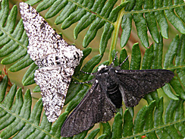
Types of variables
Categorical
Qualitative characteristics that do not have magnitude on a numerical scale (e.g., black vs white phenotypes in species with colour variation, survival rate)
Nominal—categories have no inherent order (e.g., colour morph)
http://www.mothscount.org/text/63/peppered_moth_and_natural_selection.html

Slide 31
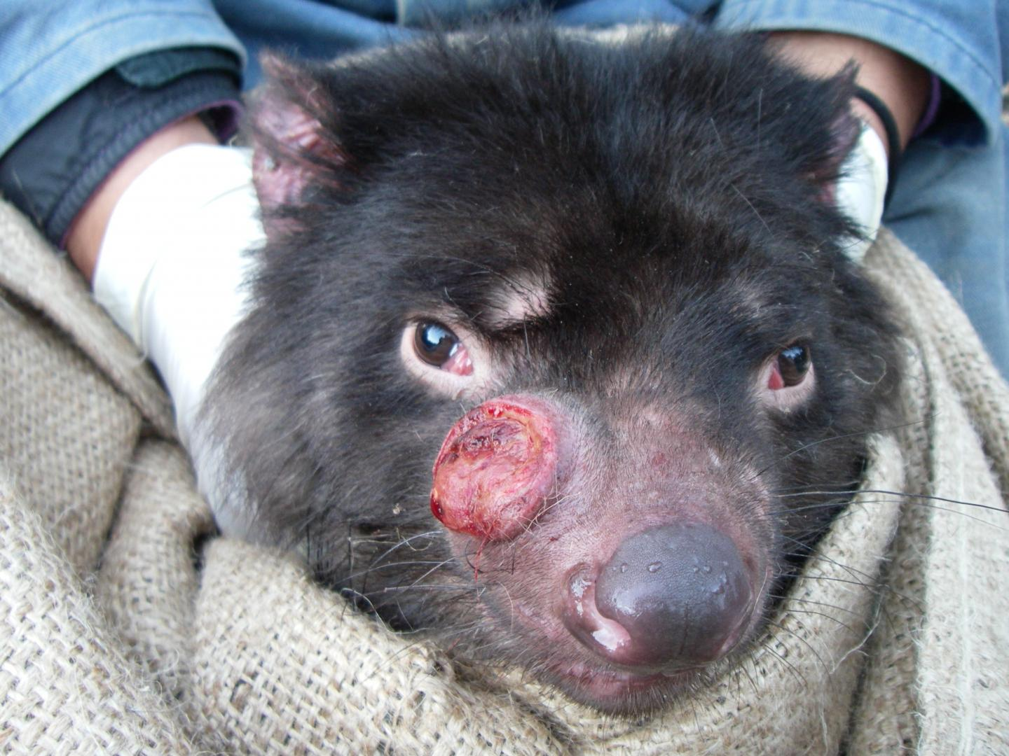
Types of variables
Categorical
Qualitative characteristics that do not have magnitude on a numerical scale (e.g., black vs white phenotypes in species with colour variation, survival rate)
Nominal—categories have no inherent order (e.g., colour morph)
Ordinal—categories can be ordered (e.g., tumour severity score ranging from low = 1 to high =5, IQ test scores), but difference between ranks unknown
http://www.mothscount.org/text/63/peppered_moth_and_natural_selection.html
https://www.eurekalert.org/pub_releases/2019-01/su-tdc012319.php

Slide 32
Types of variables
Numerical
Quantitative measurements that have magnitude on a numerical scale

Slide 33
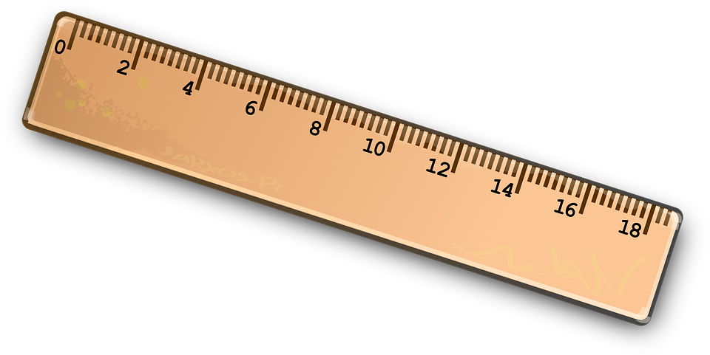
Types of variables
Numerical
Quantitative measurements that have magnitude on a numerical scale
Continuous—can take on any real-number value within a range (e.g., body mass or length)

Slide 34
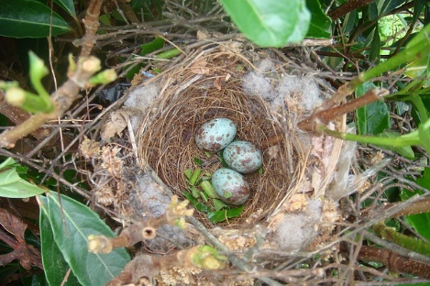
Types of variables
Numerical
Quantitative measurements that have magnitude on a numerical scale
Continuous—can take on any real-number value within a range (e.g., body mass or length)
Discontinuous or discrete—indivisible units (e.g., eggs in a clutch for birds; might approach continuous for species such as cichlid fish where there are >10 categories in a count)

Slide 35
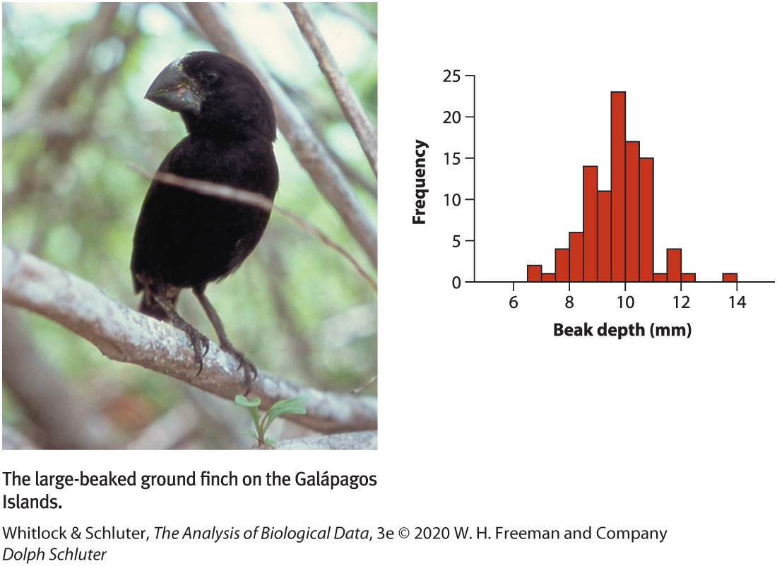
Distributions
Frequency distribution
Shows how often each value of a variable occurs in the sample

Slide 36
Distributions
Frequency distribution
Shows how often each value of a variable occurs in the sample
Reveals central tendency and dispersion

Slide 37
Distributions
Frequency distribution
Shows how often each value of a variable occurs in the sample
Reveals central tendency and dispersion
Gives an idea of how data are distributed

Slide 38
Distributions
Probability distribution
Distribution of variable in whole population

Slide 39
Distributions
Probability distribution
Distribution of variable in whole population
Almost never known

Slide 40
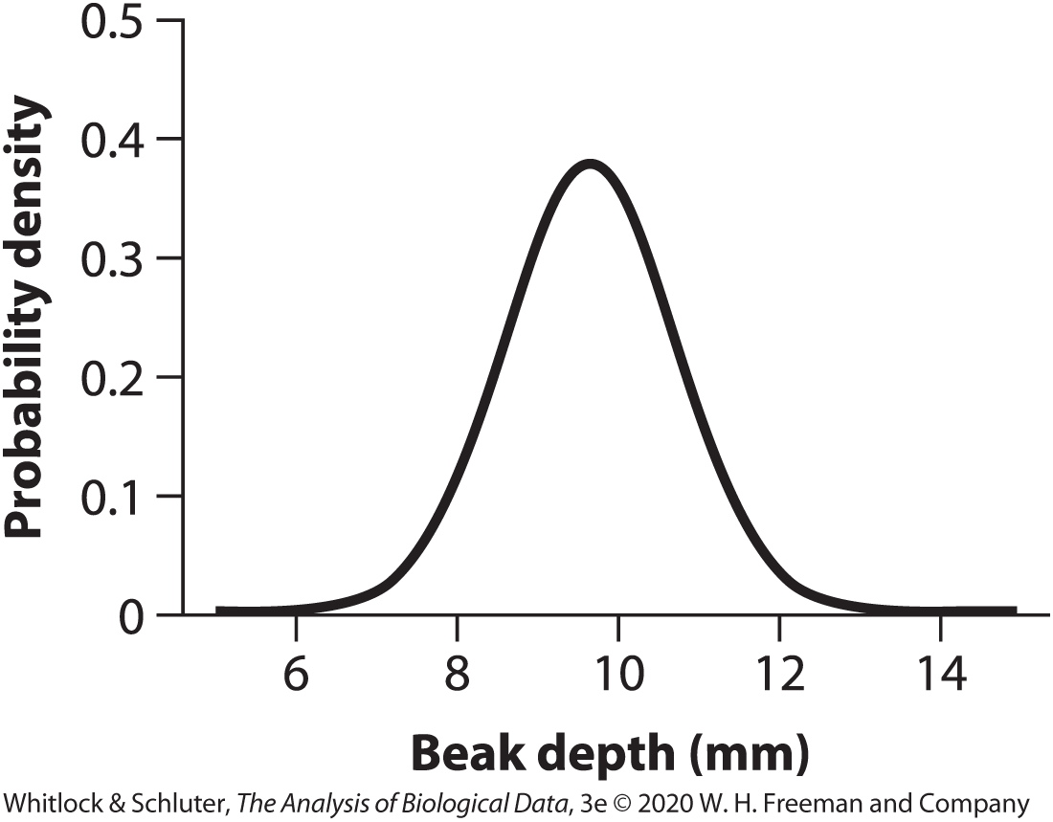
Distributions
Probability distribution
Distribution of variable in whole population
Almost never known
Theoretical probability distributions used to approximate real probability distribution (e.g., normal)

Slide 41
Types of studies
Experimental
Researcher randomly assigns treatment groups of an explanatory variable to individual units of a study

Slide 42
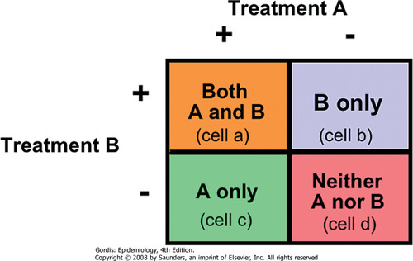
Types of studies
Experimental
Researcher randomly assigns treatment groups of an explanatory variable to individual units of a study
E.g., treatments to cells

Slide 43
Types of studies
Experimental
Researcher randomly assigns treatment groups of an explanatory variable to individual units of a study
E.g., treatments to cells
Must have replication and randomization

Slide 44
Types of studies
Experimental
Researcher randomly assigns treatment groups of an explanatory variable to individual units of a study
E.g., treatments to cells
Must have replication and randomization
Helps control for confounders

Slide 45
Types of studies
Experimental
Researcher randomly assigns treatment groups of an explanatory variable to individual units of a study
E.g., treatments to cells
Must have replication and randomization
Helps control for confounders
Can determine cause-and-effect

Slide 46
Types of studies
Experimental
Researcher randomly assigns treatment groups of an explanatory variable to individual units of a study
E.g., treatments to cells
Must have replication and randomization
Helps control for confounders
Can determine cause-and-effect
Trade-off between artificial & rigour

Slide 47
Types of studies
Observational
Assignment of treatments not made by researcher

Slide 48
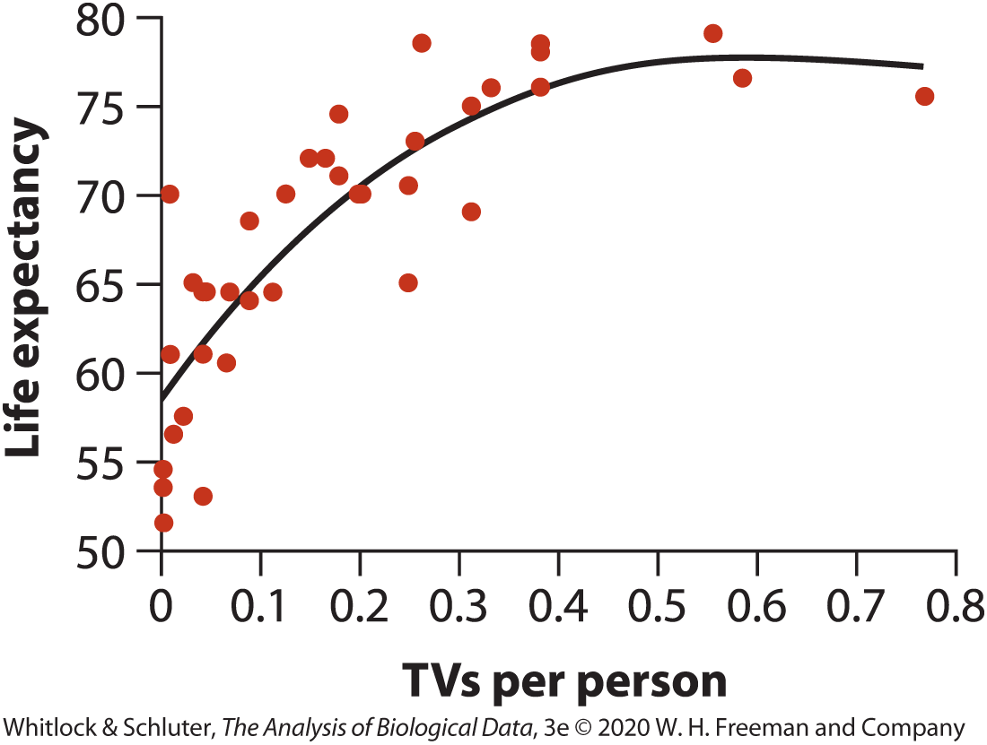
Types of studies
Observational
Assignment of treatments not made by researcher
More difficult to control for confounding variables

Slide 49
Types of studies
Observational
Assignment of treatments not made by researcher
More difficult to control for confounding variables
Can only determine associations
Can be powerful if well-panned

Slide 50
Types of studies
Observational
Assignment of treatments not made by researcher
More difficult to control for confounding variables
Can only determine associations
Can be powerful if well-panned
Sometimes only option

Slide 51
Practice Questions (from Whitlock & Schluter)
Which of the following numerical variables are continuous and which are discrete?
Number of injuries sustained in a fall
Fraction of birds in a large sample infected with avian flu virus
Number of crimes committed by a randomly sampled individual
Logarithm of body mass

Slide 52
Practice Questions (from Whitlock & Schluter)
2) What features of an estimate—precision or accuracy—is most strongly affected when individuals differing in the variable of interest do not have an equal chance of being selected?

Slide 53
Practice Questions (from Whitlock & Schluter)
3) In a recent study, researchers took electrophysiological measurements from the brains of two rhesus macaques. Forty neurons were tested in each monkey, yielding a total of 80 measurements.
Do the 80 neurons constitute a random sample? Why or why not?
If the 80 measurements were analyzed as though they constituted a random sample, what consequences would this have for the estimate of the measurement in the monkey population?

Slide 54
Practice Questions (from Whitlock & Schluter)
For the following studies, state what is the explanatory variable and which is the response variable. Also, say whether the study is observational or experimental
Forestry researchers wanted to compare the growth rates of tress growing at high altitude to those growing at low altitude. They measured growth rates using the space between tree rings in a set of trees harvested from a natural forest.
Hansen et al 2008 studied a species of spider whose females often eat males that are trying to mate with them. The researchers removed a leg from each male spider in one group (to make them more vulnerable to being eaten) and left the males in another group undamaged. They studied whether survival of males in the two groups differed during courtship.

Slide 55
Answers
a) discrete, b) continuous, c) discrete, d) continuous
Accuracy
a) Neurons were not sampled randomly. Multiple neurons from the same monkey are not independent—they are likely to be more similar to one another in their measurements than neurons chosen randomly from the population.
b) The calculation of the precision of estimates would be erroneous
4) a) Altitude: explanatory, growth rate: response, Observational.
b) Leg removal: experimental, survival: response, Experimental.

